Slide 1
Warehouse Management (WM)
Curriculum: Introduction to S/4HANA using Global Bike

Slide 2

4.2 (August 2023)
SAP S/4HANA 2022
Fiori 3.0
Global Bike
No Prerequisites needed

Slide 3
Chris Bernhardt
Babett Ruß
Beginner

Slide 4
You are able to
name some functionalities of the WM module.
define the central organizational structures of the WM module.
summarize the master data which is most important for the WM module.
explain standard Warehouse Management processes.

Slide 5
Functionality
Goods Receipt
Goods Issue
Picking
Packing
Shipping
Physical Inventory

Slide 6
Agenda
WM Organizational Structure
WM Master Data
WM Process Management and Control

Slide 7
Agenda
WM Organizational Structure
WM Master Data
WM Process Management and Control

Slide 8
WM Organizational Structure
Global Bike
Client
Global Bike Inc. US
Global Bike Inc. DE
Company Code
Dallas
San Diego
Miami
Plant
Trading Goods
Finished Goods
Miscellaneous
Storage Location
San Diego Warehouse
Warehouse Number
Shelf Storage
GR Area Ext.
Receipts
Pallet Storage
Shipping area
Deliveries
Stock Transfers
(Plant)
Storage Type
Total Section
Storage Section

Slide 9
WM Organizational Structure
Client
An independent environment in the system
Company Code
Smallest org unit for which you can maintain a legal set of books
Plant
Operating area or branch within a company
Manufacturing, distribution, purchasing or maintenance facility
Storage Location
An organizational unit allowing differentiation between the various stocks of a material in a plant

Slide 10
WM Organizational Structure
Warehouse Number
Number that identifies a complex, physical warehouse structure within the warehouse management system
Storage Type
Subdivision of a complex, physical warehouse
Is identified by its warehousing technique, form of organization, or its function
Storage Section
Logical or physical subdivision of a storage type
Groups together a series of similar storage bins
Picking Area
Groups storage bins together from the standpoint of picking strategies

Slide 11
WM Organizational Structure
Warehouse door
Marks the point where the means of transport changes to an internal transportation
Allocation Zone
Temporary storage of goods, which have just arrived or will be shipped soon
Shipping Point
Is the part of the company responsible for the type of shipping, the necessary shipping materials and the means of transport
Storage Bin
Smallest addressable unit in a warehouse, which identifies the exact location in the warehouse where goods can be stored
→ Master Data

Slide 12
Global Bike Structure for Warehouse Management
Global Bike
Client
Global Bike Inc. US
Global Bike Inc. DE
Company Code
Dallas
San Diego
Miami
Plant
Trading Goods
Finished Goods
Miscellaneous
Storage Location
San Diego Warehouse
Warehouse Number
Shelf Storage
GR Area Ext.
Receipts
Pallet Storage
Shipping area
Deliveries
Stock Transfers
(Plant)
Storage Type
Total Section
Storage Section
STBN-2-000
STBN-2-001
STBN-2-999
Storage Bin

Slide 13
Global Bike Enterprise Structure in SAP ERP (Logistics)
Shipping Point
DL00
MI00
SD00
TO00
HD00
HH00
PE00
RM00
TG00
TG00
TG00
RM00
TG00
TG00
Storage
Location
SF00
FG00
FG00
FG00
SF00
FG00
FG00
FG00
MI00
MI00
MI00
FG00
MI00
MI00
MI00
MI00
Central Purchasing Organization (global) GL00
Purchasing Org. US00
CA00
PO DE00
AU00
Purchasing Group North America
N00
PGr Europe
E00
Asia
A00
Dallas
DL00
Miami
MI00
S. Diego
SD00
Toronto
TO00
Heidelb.
HD00
Hamburg
HH00
Perth
PE00
Plant
CC US00
CA00
CC DE00
AU00
Company Code
Client Global Bike
Notes:
Organizational units displayed in grey are not yet implemented, but are already planned in Global Bike.

Slide 14
Agenda
WM Organizational Structure
WM Master Data
WM Process Management and Control

Slide 15
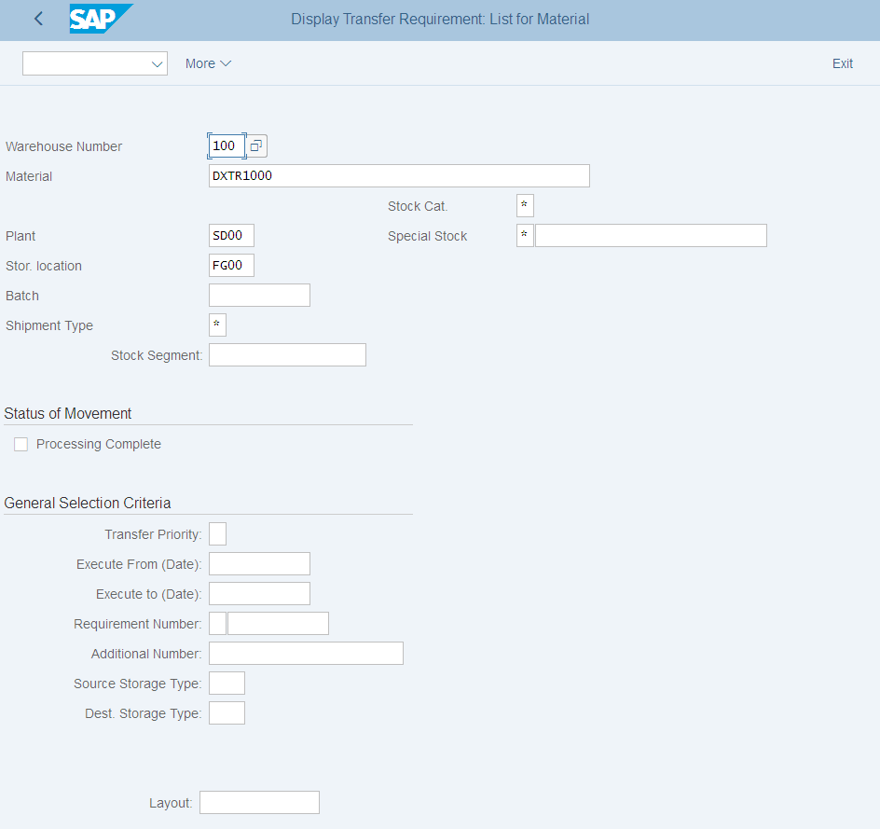
WM Master Data
Storage Bin Master Data
Material Master Data
Hazard Master Data
Batch Master Data

Slide 16
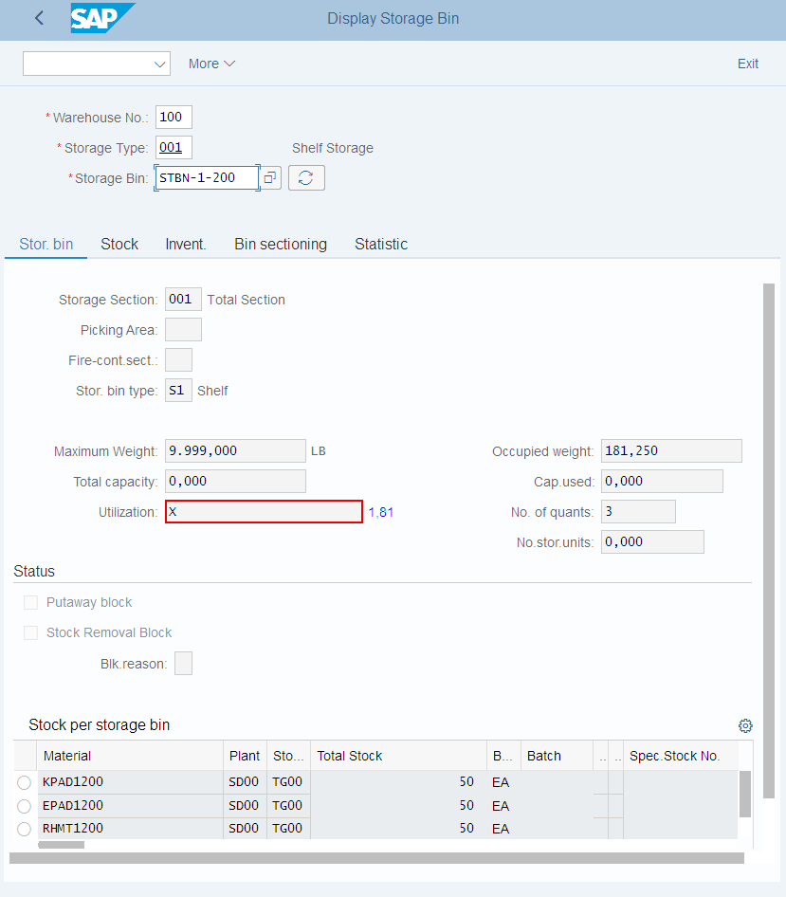
Storage Bin Master Data
Storage Bin Master Data
Two different organizational levels
Warehouse Level: All indicators and fields which are valid for the whole warehouse
Storage Type Level: All indicators which are only valid for specific storage types
Also includes Storage Bins and Quants

Slide 17
Storage Bin Master Data
Storage Bin
Smallest addressable unit in a warehouse
General Data
Warehouse
Storage type
Storage bin number
Storage Bin Data
Storage section
Picking area
Fire-containment section
Bin type
Max. weight
Status
Blocked for putaway
Stock removal block
Blocking reason
General Data
Storage Bin Data (WM)
Status (MM)

Slide 18
Storage Bin Master Data
Quant
Smallest addressable unit of measure for a material in SAP S/4HANA
General Data
Material
Plant / Storage location
Batch
Warehouse
Storage type
Storage bin
Stock Data
Total stock
Available stock
Block Indicator
Block
Putaway/removal status
General Data
Stock Data (MM)
Blocking Indicator (MM)

Slide 19
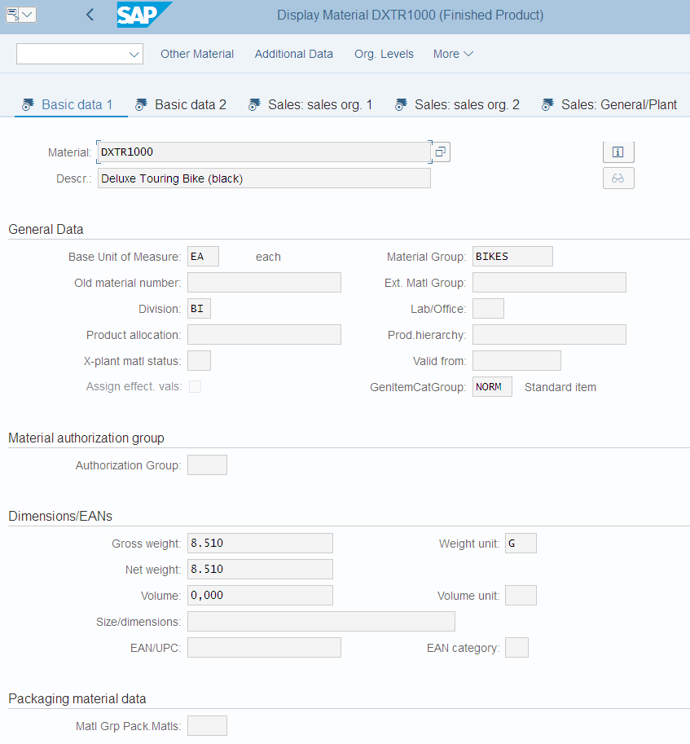
Material Master Data
Material Master
Contains all the information a company needs to manage a material
It is used by most components within the SAP system
Sales and Distribution
Materials Management
Production
Plant Maintenance
Accounting/Controlling
Quality Management
Material master data is stored in functional segments called Views

Slide 20
Material Master Views
Sales Data
Basic Data
Warehouse Mgmt.
Material Master
Mat. Plan. Data
Forecasting Data
Storage Data
Controlling Data
Quality Data
Accounting Data

Slide 21
Material Master
General Information relevant for the entire organization:
Name Weight Unit of Measure
Client XXX
Sales specific information:
Delivering Plant Loading Grp
Storage Location specific information:
Stock Qty
Sales Org. UW00
Storage Loc. FG00
Sales Org. UE00
Storage Loc. TG00
Notes:
All of this together makes up the Master Record for a Material.

Slide 22
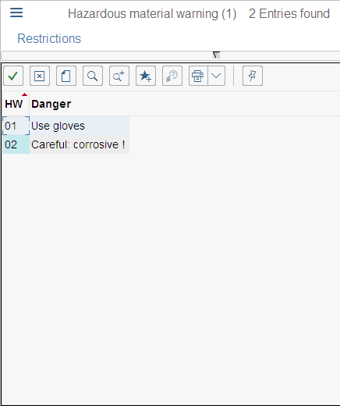
Hazard Master Data
Storage area for hazardous materials
Flammable liquids
Toxic materials
Radioactive materials
General Data
Storage class
Water pollution class
Flash point
Aggregate state
Hazardous material warning
Hazardous substance number

Slide 23
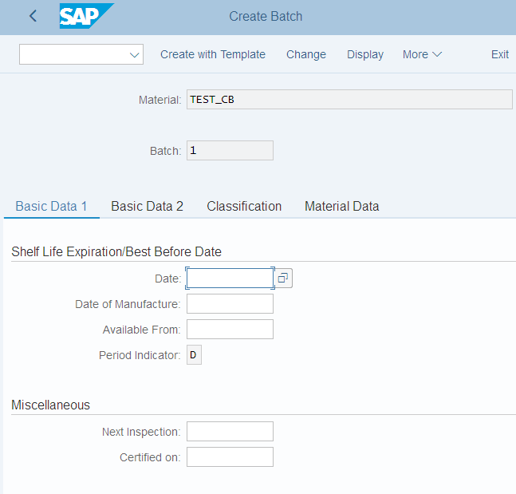
Batch Master Data
Subset of Material
homogeneous series of unreproducible units with a unique specification
Basic Data 1 & 2
Expiration date
Inspection date
Trading data
Administration data
Text data
Classification of Batch
Material data

Slide 24
Agenda
WM Organizational Structure
WM Master Data
WM Process Management and Control

Slide 25
WM Types of goods movements
Plant 1
Plant 2
Storage Loc. 1
Storage location 2
Vendor
Production
Unrestricted-
use stock
Stock in quality inspection
Storage location 3
Production
Customer
Blocked stock

Slide 26
Transfer posting and stock transfer
Transfer posting
Change to stock type, material number or batch
number
Additional physical material
movement possible
Stock to stock
Material to material
Consignment to warehouse
Stock transfer
Physical material
movement
Once- and two-step
procedures possible
Stor. loc to stor. loc
Plant to plant
Company code to company code

Slide 27
One-Step/Two-Step Procedures
Issuing organizational level
Receiving organisational level
Stock
Stock in
transfer
Step 1: Remove fr. storage
Step 2: Place in storage
Step 1: Remove fr. storage
+
Step 2: Place in storage
Stock

Slide 28
Stock transport order
A Stock Transport Order (STO) is a purchase order used to request or instruct a plant to transport material from one plant to another (that is, to effect a long distance physical stock transfer) within the same corporate enterprise.
The stock transport order allows delivery costs incurred as a result of the stock transfer to be charged to the material transported.
Issuing plant
Receiving plant
Storage location
Stock transp.
order
Unrestricted-
use stock
Storage Loc
Unrestr.-use
stock
Stock in
transit
Stock in
quality insp.
Blocked
stock

Slide 29
WM Processes
Logistics Execution
Goods receipt
Goods issue
Goods receipt posting
Goods issue posting
Transfer requirement
Transfer requirement
Putaway with
transfer order
Picking with
transfer order
Confirm transfer order
Confirm transfer order

Slide 30
WM Process Management and Control
Posting change notice (PCN)
Generated by posting change processes in WM-administrated stocks
Functionality similar to transfer requests
Not necessarily combined with a physical goods movement
Transfer requirement (TR)
A request to transfer materials at a particular time from a source storage bin to a destination storage bin in a warehouse complex
Represents the expected and scheduled goods movements in WM
Normally generated by postings in the inventory management
Consists of transfer request header and line items
Transfer order (TO)
Central documents for WM
Every material movement requires a transfer order
No difference between real and logical movement

Slide 31
Transfer Order
Creation of transfer order depends on preceding document
Transfer request
Posting change notice
Outbound delivery
Inbound delivery
Types of Transfer Order Creation
Manual (TR, PCN, material document)
Direct TO-Creation
Automatic TO-Creation
Manual (Delivery Monitor)

Slide 32
Inventory
Periodic inventory
Continuous inventory
Inventory on putaway
Zero stock check
Sample-based physical inventory
Cycle-Counting
Notes:
Cycle-Counting is based on an ABC-Analysis

Slide 33
Physical inventory process
Create physical inventory document
Activate physical inventory document
Print warehouse inventory list
Enter count results
Clear differences in the warehouse management
Clear the differences in the inventory management
Notes:
Create physical inventory document -> Flag storage bins for inventory
Activate physical inventory document -> Storage bins are blocked
Print warehouse inventory list -> Inventory report RLLI0400
Enter count results -> Get differences
Clear differences in the warehouse management -> Release storage bins
Clear the differences in the inventory management -> Create material document and accounting document

